Slide 1
G.H.O.S.T · Threat Modeling for Modern Game Ecosystems
“Threats shift constantly. What they target rarely does.”
Harikrishnan Santhanaraghavan (Hari)
Mentored by Sebastien Deleersnyder

Slide 2
G.H.O.S.T | THE QUESTION
what if
nothing
needs to be broken
for an attack to succeed?

Slide 3
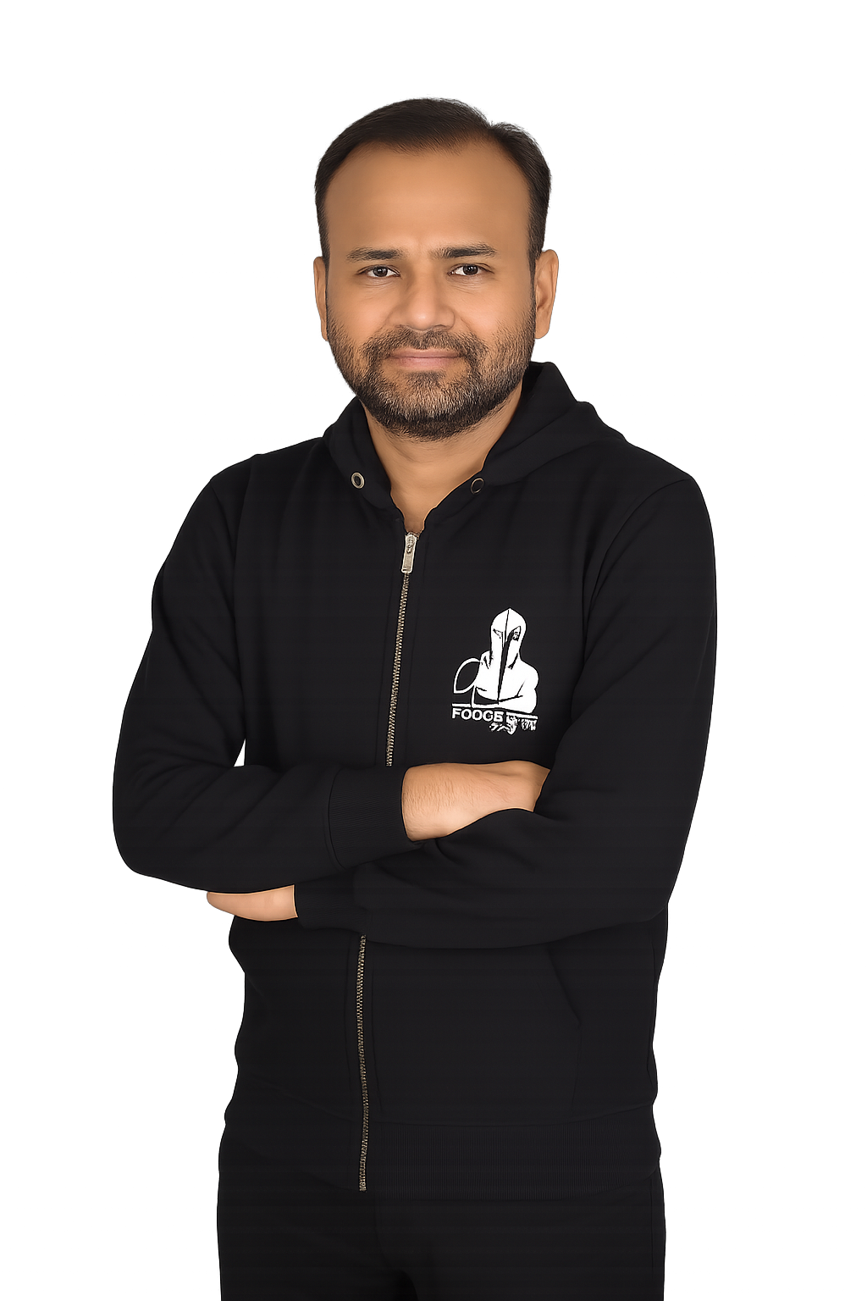
Harikrishnan Santhanaraghavan (Hari)
IT Architect
Allianz Technology SE
Munich, Germany

Slide 4
No Exploit, Still Compromised !
G.H.O.S.T | INTRO
01 · GROOMING
02 · COORDINATED LOAD
03 · IMPERSONATION
"hi! whats your age?"
LOAD
✓
REAL · trusted
"i play too — be friends?"
✓
100%
@john_doe
"dont tell ur parents"
✓
ADULT
MINOR
✓
↓ one-character swap
"send a pic, just us"
IMPOSTER · unverified
escalating over days / weeks
0%
@john_d0e
✓ messages allowed
✗ context harmful
✓ each request valid
✗ pattern fails
✓ trust granted
✗ identity false
An adult builds trust with a minor over time. No single message is harmful.
A coordinated group floods a platform with legitimate-looking requests.
A trusted identity is impersonated through a one-character name variation.
No policy keyword fires.
No exploit was used.
No authentication failed.
Attacks that succeed without technical exploits, by operating within expected behavior.

Slide 5
Existing knowledge on socio-technical risks
G.H.O.S.T | EXISTING RESEARCH REFERENCES
ACADEMIC
INDUSTRY / OPS
REGULATORY
Formal threat models for user-to-user harm
Operational frameworks from T&S practice
Statutory duties driving systemic risk assessment
Abusability Analysis
DISARM (ex-AMITT)
DSA Art. 34 / 35
USENIX 2025 — generalised framework for at-risk users (IPV, trafficking, elder abuse).
MITRE-style framework for influence ops and coordinated inauthentic behaviour.
VLOPs must assess systemic risk: minors, mental health, civic discourse, fundamental rights.
IPV Threat Model
FIST (June 2025)
Ofcom abusability testing
Slupska et al. — dedicated threat model for technology-facilitated abuse.
Fraud Incident Structured Threat — psychological + technical fraud modeling.
UK Online Safety Act — platforms must test how features enable malicious users.
LINDDUN
Trust & Safety bodies
Roblox Sentinel (OSS)
STRIDE-modelled privacy framework: identifiability, linkability, unawareness.
DTSP Safe Framework (now ISO/IEC 25389), ActiveFence (incl. Spectrum Labs) — established T&S methodology.
Production grooming-detection system, open-sourced for industry use.

Slide 6
G.H.O.S.T | THE FRAMEWORK
A multiplayer game isn't just software.
It's a living social ecosystem.
So, we built a framework that treats it that way:
G.H.O.S.T

Slide 7
The Five Domains of G.H.O.S.T
G.H.O.S.T | THE FRAMEWORK
A threat modeling framework built from first principles for player-driven systems.
G
GAMEPLAY
Integrity of the platform's own rules and mechanics
T
H
TRADE
HARM
Legitimacy of value exchange and economic activity
Safety of users from harmful intent by other users
G.H.O.S.T
Multiplayer game
threat modeling
S
O
SOCIAL
OPERATIONS
Authenticity of identity, attribution, and relationships
Availability and consistency under adversarial conditions
Five concerns. One platform. Threat modeling built for player-driven systems.

Slide 8
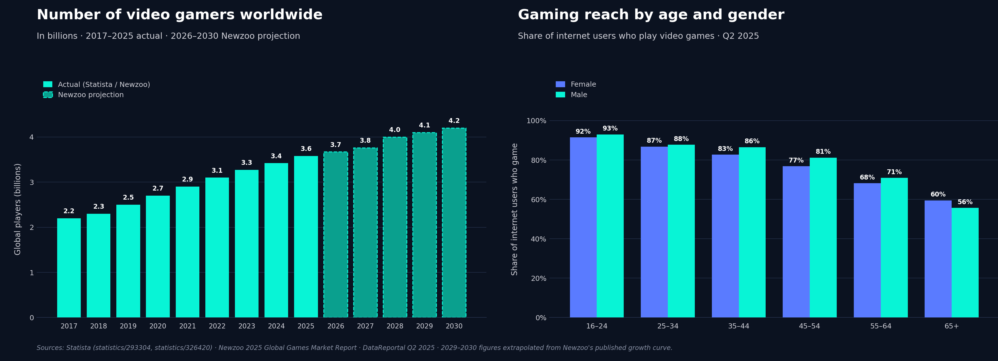
Why Focus on Gaming ?
G.H.O.S.T | CONTEXT
Statista | Newzoo

Slide 9
G.H.O.S.T | OUR APPROACH
Every multiplayer game has the
same things worth defending.
We organize them into:
Six Surfaces.

Slide 10
Threats Land where Players Play !
G.H.O.S.T | THE ARCHITECTURAL LAYER
Five surfaces where players experience the game. One where the system runs.
1
USER
Where an individual actor directly interacts with the game.
2
INTERACTION
How actors interact with each other — chat, voice, party play.
3
ENVIRONMENT
The shared, persistent world that all actors operate within.
4
VALUE
Economy, assets, transactions, entitlements, transferable worth.
5
CONTENT
Everything created, uploaded, or published by players or the system.
6
OPERATIONS
Backend services and infrastructure — the technical substrate.
Six surfaces, every component placed. This is how we organize what's worth defending .

Slide 11
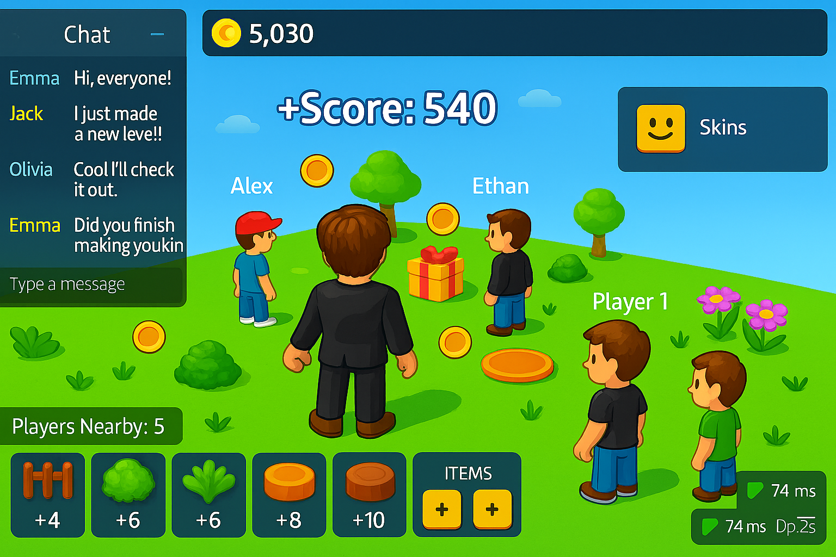
All Six Surfaces, Visible on One Screen
G.H.O.S.T | GAME SURFACES EXAMPLE
Every UI element a player sees lives on exactly one surface. Once you know where to look, the architecture is already in front of you.
WHAT YOU'RE LOOKING AT
2
4
1
USER
Your character,
5
3
2
INTERACTION
Party voice, chat, messages between players
3
ENVIRONMENT
The shared world, terrain, other players
1
4
VALUE
Resources, currency, inventory counts
5
CONTENT
Held weapon, cosmetics, player-published items
4
6
6
OPERATIONS
Session info, server health, latency
This isn't a special analytical view — it's the normal player UI. The framework's surfaces are how the game already presents itself.

Slide 12
G.H.O.S.T | BEFORE WE MODEL THREATS
Threats shift constantly.
What they target rarely does.
These targets have a name:
Invariants.

Slide 13
Invariant-Anchored Telemetry (IAT)
G.H.O.S.T | THE METHODOLOGY
A three-level derivation that grounds universal properties in observable telemetry — and binds named threats to the signals that detect them.
01
What must hold?
EXAMPLE
INVARIANTS
e.g. 'Player identity must not be impersonable.'
Tend to hold across platforms and time. Independent of features.
Universal properties
02
What do we measure?
EXAMPLE
TELEMETRY
identity_create_or_rename { player_id, handle, similarity_to_existing, decision }
Each invariant produces required telemetry — events, fields, and emission triggers tied to platform surface.
Observable evidence
03
What are we catching?
EXAMPLE
THREATS
e.g. 'Look-alike username' · ‘Homoglyphs' · 'Impersonation account'
Named for the ecosystem. Illustrative, not exhaustive. Each threat binds to a filter on the telemetry above.
Detections bound to telemetry
Threat categories shift across platforms. Telemetry varies with platform surface. Invariants stay fixed. IAT makes that boundary explicit — and traceable both ways.

Slide 14
The Fifty Non-Negotiables
G.H.O.S.T | GLOBAL INVARIANTS
Fifty invariants across five domains - each anchored to the telemetry event that proves or disproves it.
GAMEPLAY
G
HARM
H
OPERATIONS
O
SOCIAL
S
ECONOMY
T
Fairness & Authority
Player Wellbeing
Resilience & Availability
Identity & Trust
Value Integrity
01
Server is the final authority over outcomes
01
Player expression does not cause harm to others
01
All external inputs are validated
01
Player identity is not impersonable
01
Value cannot be duplicated
server_validated_action
expression_event
input_validation_result
identity_create_or_rename
value_transfer
02
Player inputs cannot yield super-human performance
02
Harmful behavior patterns are detectable over time
02
Systems tolerate malformed or hostile input
02
Trust and reputation are difficult to game
02
Economic state has a single source of truth
input_rate_sample
behavior_score_update
input_parse_outcome
reputation_delta
balance_snapshot
03
Rules are enforced consistently across players
03
Minors are protected from manipulation
03
Services resist traffic floods and abuse
03
Group behavior cannot bypass safeguards
03
Transfers are atomic and consistent
rule_evaluation
age_gated_interaction
rate_limit_event
group_action
transfer_outcome
04
Game state stays synchronized for participants
04
Sexual / graphic content is appropriately gated
04
Failures are isolated and non-cascading
04
Coordination patterns are observable
04
Trades cannot be replayed
state_sync_event
content_render
circuit_breaker_state
coordination_signal
trade_submission
05
Timing is not exploitable for advantage
05
Threats or intimidation trigger intervention
05
Resource exhaustion is detectable
05
New identities do not gain instant influence
05
Economic actions are attributable
action_timing
threat_signal
resource_utilization
privilege_check
economic_action_log
06
Progression advances only via legitimate gameplay
06
Harmful identity representations are controlled
06
Unexpected traffic patterns are observable
06
Reputation changes are attributable
06
Market manipulation is detectable
progression_change
identity_field_change
traffic_pattern_sample
reputation_event
market_pattern_signal
07
Randomized mechanics are not predictable
07
Players can report harmful behavior
07
Operational limits are enforced
07
Social hierarchies resist abuse
07
Collusive behavior leaves observable signals
rng_draw
report_submitted
limit_enforcement
role_action
match_outcome_correlation
08
Actions cannot be replayed for additional benefit
08
Reports result in observable handling
08
Failures produce diagnostic telemetry
08
Harassment is distinguishable from normal play
08
High-value operations are logged
action_submission
report_state_change
error_event
interaction_pair_signal
high_value_action
09
Client-reported state is never blindly trusted
09
Safety controls resist evasion
09
Recovery behavior is visible
09
Community actions are auditable
09
Rollbacks and reversals are auditable
client_claim
control_evaluation
recovery_event
community_action_log
reversal_event
10
Non-prod / debug paths do not affect live play
10
Enforcement actions are attributable
10
Degraded operation is detectable
10
Social enforcement is visible
10
Economy-wide anomalies are detectable
code_path_invocation
enforcement_decision
service_health
enforcement_visible
economy_health_sample
Each invariant anchors a telemetry event. Threats bind to filters on those events. Activation status records whether the telemetry is present, latent, collapsed into another signal, or N/A.

Slide 15
The same fifty, organized two ways
G.H.O.S.T | ORGANIZING THE INVARIANTS TO DOMAINS & SURFACES
By domain (G·H·O·S·T) — what the invariant protects. By surface — where it lives. Two valid pivots on the same artifact.
USER
INTERACTION
ENVIRONMENT
VALUE
CONTENT
OPERATIONS
TOTAL
WHAT THE DISTRIBUTION SHOWS
G
Gameplay
4
—
5
—
—
1
10
1
Two domains map to a single surface
Operations the domain is 100% on Operations the surface. Trade & Economy is 100% on Value. Those domains ARE their surface — they're not cross-cutting concerns.
H
Harm
2
3
—
—
2
3
10
2
Three domains are cross-cutting
O
Operations
—
—
—
—
—
10
10
Gameplay, Harm & Safety, and Social Systems each span multiple surfaces. A G-domain invariant might live on User OR Environment OR Operations.
S
Social
4
5
—
—
—
1
10
T
Trade
—
—
—
10
—
—
10
TOTAL
10
8
5
10
2
15
50
One artifact, two pivots. Domain answers what it protects. Surface answers where it lives.

Slide 16
G.H.O.S.T | HOW WE MODEL THREATS
How to operationalize
the Invariants.
The approach is:
Test-Driven Threat Modeling

Slide 17
Test-Driven Threat Modeling (TDTM)
G.H.O.S.T | THE OPERATIONALIZATION
Tests bind invariants to telemetry to threats. Walk the chain forward to design defenses. Walk it back to investigate incidents.
→ FORWARD: design defenses (invariant → tests → threats caught)
01
INVARIANT
02
TELEMETRY
03
TESTS
04
THREATS
What must hold?
What do we measure?
How do we know it works?
What do we catch?
S01
EVENT
3 TESTS
CAUGHT BY THIS CHAIN
SOCIAL · USER surface
identity_create_or_rename
T-S01-01
PASS
Look-alike username
Player identity must not be impersonable.
{
EXISTENCE TEST
filter: similarity > 0.85 AND decision = 'allow'
player_id,
handle,
similarity_to_existing,
decision
Event emits on every identity create/rename — including rejected attempts.
T-S01-02
PASS
Handle squat
SCHEMA TEST
filter: handle matches reserved/trademark list
A universal property. Holds across platforms and time. Independent of the specific identity surface a platform exposes.
}
All four fields present + similarity_to_existing is a numeric score.
EMITS ON
T-S01-03
PASS
Every identity-creation or rename request — even when the request is rejected.
Impersonation account
DETECTION TEST
filter: handle pairs with another player's avatar/region
Detection fires on synthetic look-alike handle inputs.
Framework-provided
Framework-provided · platform-emitted
3 / 3 pass → invariant ACTIVE
Ecosystem-specific · extensible
← REVERSE: investigate incidents (threat seen → test that fires → invariant violated)
If any test fails, the invariant downgrades from Active.

Slide 18
G.H.O.S.T | ACROSS THE DOMAINS
Threats don't sit still.
They move between domains.
We trace them across the framework:
Propagation Chains.

Slide 19
Threats rarely stay in one domain !
G.H.O.S.T | PROPAGATION CHAINS
Example chain · H → S → T · harm enables deception; deception enables exploitation. Each step looks benign in isolation.
STEP 1
STEP 2
STEP 3
H
S
T
HARM
SOCIAL
TRADE
Actor establishes manipulative relationship with target. Trust built across sessions. No harmful keywords. No isolated policy violation.
Actor presents fabricated identity — look-alike username, spoofed credential. Target already trusts; accepts. No identity check failed.
Actor directs target to transfer value. Transaction is valid. Transfer is voluntary. No fraud signal fires.
TELEMETRY HOOK
TELEMETRY HOOK
TELEMETRY HOOK
msg.risk.score
identity.similarity.check
value.transfer.context
escalating intimacy + secrecy signals
name within edit-distance threshold
transfer correlated with flagged interaction
Each step looks benign on its own. The chain reveals the pattern.

Slide 20
G.H.O.S.T | DEMO
Tic-Tac-Toe,
theghostmodel.com
PLAYERS
instrumented with G.H.O.S.T.
Player 1
X
Player 2
O
X
O
A minimal platform with toggleable controls and telemetry. Watch invariants activate and degrade in real time.
X
O
TRY IT YOURSELF @
theghostmodel.com
CHAT
Player 1: gg
Player 2: nice play

Slide 21
G.H.O.S.T | GHOST AI
Most telemetry require observation.
But some require interpretation.
Our reference interpreter:
GHOST-AI.
Pluggable. Replaceable.

Slide 22
GHOST AI Architecture
G.H.O.S.T | GHOST AI ARCHITECTURE
An LLM wrapper anchored to a curated abusive-language catalog. Produces the telemetry the framework's invariants already expect.
GHOST AI ARCHITECTURE
WHAT IT IS
A reference classifier.
INPUT
"you suck noob get off the server"
Chat message from player
An LLM wrapper anchored to a curated abusive-language catalog. Its a pluggable companion.
Raw text · sender identity · session context
GHOST-AI
WHAT IT PRODUCES
Abusive Language Detector
CATALOG
PROMPT
LLM
SCORE
Telemetry the framework already expects.
Compose prompt → call LLM → extract score
GHOST-AI emits the exact event schemas H01 and H05 require. No translation layer needed.
TELEMETRY
expression_event { classifier_score: 0.91 } threat_signal { class: 'harassment' }
Framework events emitted
Same schema the framework already expects
WHY IT MATTERS
INVARIANT BINDING
The catalog stays. The LLM can change.
H01 + H05 trigger
H01 ACTIVE
H05 ACTIVE
The framework already knew what to do with this telemetry
Swap providers — GPT, Claude, open-source, on-device. The catalog is the durable artifact. The framework's invariants don't depend on either.
The catalog is the contract with the framework. The LLM is just how we honor it.

Slide 23
G.H.O.S.T | GHOST-AI
Finite framework.
Infinite Coverage.
Three things before we close:
1
SCALE
2
PRIORITIZATION
3
ACCESS
What the framework produces.
Score what to model
First.
Where you can get it today.
Five decisions cascade into one hundred fifty tests and unbounded threat coverage.
AGE-X — a risk-scoring matrix that adds user-population vulnerability to the formula, where most frameworks leave it at zero.
Demo, templates, code, and slides — all open, all available now.
www.theghostmodel.com

Slide 24
The arithmetic of coverage !
G.H.O.S.T | HOW IT SCALES
Each layer of the framework expands into the next. Pick a domain, get invariants. Pick an invariant, get telemetry and tests. Each test catches a class of threats.
5
DOMAINS
G
H
O
S
T
Gameplay · Harm · Operations · Social · Trade
50
INVARIANTS
Universal properties — 10 per domain
150
TESTS
Minimum 3 per invariant — Existence · Schema · Detection
~200
NAMED THREATS
In the illustrative catalog. Each test filter catches a threat.
∞
EVOLVING THREATS
∞
Specific attacks keep evolving. The invariants don't.
Finite Framework. Infinite Coverage.

Slide 25
Try it. Run it. Make it yours,
G.H.O.S.T | ARTEFACTS
▶
LIVE DEMO
{ }
EVERYTHING ELSE
theghostmodel.com
github.com/TheGHOSTModel/ghost
Tic-Tac-Toe + Chat, fully instrumented with toggleable controls and telemetry.
Framework spec, threat catalog, telemetry schemas, IAT templates, AGE-X matrix, slides, and the traceability tooling — all in one repo.
Open in any browser
Clone or fork
⬜
TEMPLATES
★
PRIORITIZATION
◫
THIS DECK
IAT spreadsheets
AGE-X matrix
Slides & notes
Four versions — light + dark, blank + worked example. With Test Traceability for TDTM.
Risk-scoring rubric. Formula, criteria, weight justification, scoring template for your platform's components.
All the slides from this talk, with full speaker notes. Use them, remix them, adapt them.
/templates
/scoring
/deck
Five domains. Fifty variants. One hundred fifty tests. One framework you can use today.

Slide 26
G.H.O.S.T | Q&A
Q & A

Slide 27
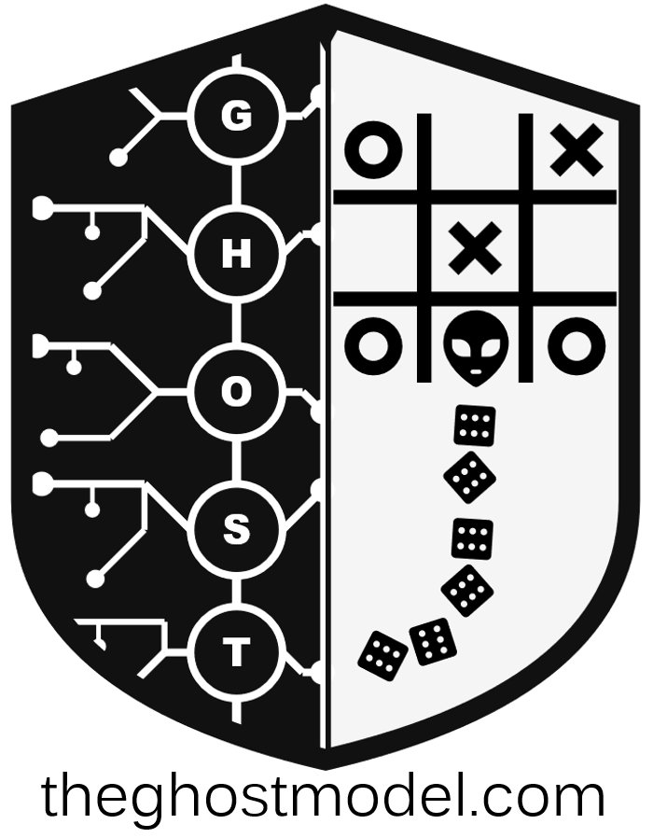
G.H.O.S.T
G.H.O.S.T | THANK YOU
Thank you for
this opportunity.
Threats shift constantly. What they target rarely does.
TAKE IT WITH YOU
Web
theghostmodel.com
Git
github.com/theGHOSTmodel/ghost
Contact
linkedin.com/in/harikrishnanss

Slide 28
G.H.O.S.T | Appendix
Appendix

Slide 29
Deciding what to model first !
G.H.O.S.T | PRIORITIZATION
A risk-scoring matrix for deciding which app components to test first. AGE-X adds user-population vulnerability as a first-class driver.
Risk Score =
(.20 × PRI) + (.15 × RPE) + (.15 × UBC) + (.15 × AGE-X) + (.15 × PP) + (.10 × FE) + (.10 × CIA)
CODE
CRITERIA
MEASURES
WEIGHT
HOW TO APPLY
PRI
Business Priority
Strategic and revenue importance
20%
1. Score each app component 1–5 on every criterion. 2. Apply the weighted formula to get a Risk Score. 3. Sort components by score, descending. 4. Instrument the top of the list first.
RPE
Regulatory Exposure
GDPR, COPPA, DSA, OSA obligations
15%
UBC
User-Base Coverage
Proportion of users touching this surface
15%
AGE-X
Age-Group Exposure
Risk to or from vulnerable populations
15%
PP
Propagation Potential
Can threats spread to other surfaces?
15%
AGE-X — THE INTENTIONAL ADDITION
FE
Financial Exposure
Direct monetary risk to users or platform
10%
Most risk-scoring matrices don't measure vulnerability of the user population.
CIA
CIA Impact
Confidentiality, Integrity, Availability
10%
For platforms serving minors or at-risk users, treat AGE-X as a first-class risk driver — not an optional secondary concern.
Weights are tunable per platform. Default shown. What matters is that AGE-X is in the formula.

Slide 30
Games are the cleanest case. Not the only one.
G.H.O.S.T | BEYOND GAMING
Anywhere strategic actors interact under shared rules, the framework's surfaces, invariants, and telemetry apply. Gaming made the examples concrete — but the structure isn't gaming-specific.
WHERE THE FRAMEWORK ALSO APPLIES
THE STRUCTURAL CLAIM
Any system where multiple actors interact strategically under shared rules
MARKETPLACES
SOCIAL PLATFORMS
FINTECH
Amazon · eBay · Etsy · Vinted
Twitter · TikTok · Reddit · LinkedIn
Banking · payments · crypto exchanges
THREATS:
THREATS:
THREATS:
Fake reviews · seller fraud · price manipulation · counterfeit
Coordinated inauthentic behavior · brigading · harassment campaigns
Wash trading · pump & dump · money laundering · identity fraud
is a game.
In the formal sense:
Strategic interaction
DATING / MATCHING
GIG ECONOMY
CONTENT PLATFORMS
Actors can affect each other's outcomes
Tinder · Hinge · Bumble · OkCupid
Uber · DoorDash · Fiverr · Upwork
YouTube · Twitch · Spotify · Patreon
Information asymmetry
THREATS:
THREATS:
THREATS:
Some actors know more than others
Romance scams · catfishing · stalking · coercion
Account farming · rating manipulation · driver / rider gaming
Engagement fraud · copyright abuse · payout manipulation
Incentive misalignment
What actors want diverges from what the platform wants
Same surfaces. Same invariants. Same telemetry. Different domain — same structure.

